Slide 1

Raytheon Senior Design
Ryan Havens | Melvin Sajeev | Cameron Sutton | Ibrahim Barney | Nisai Sun
Spring 2024 - SE4485.001 (Dr. Eric Wong)
Marc Perna

Slide 2

Project Overview
The purpose of the project was to acquire experience working with a large set of data and learning new technologies.
The project covered topics from data science, machine learning, and full stack development.
The project also gave experience working through the various stages in software lifecycle development and drafting of purposeful documents.
Project gave experience working within a team and delegating tasks. Ensuring deadlines were hit on time.

Slide 3
Scope / Deliverables
Scope:
The scope of this project covers managing large amounts of data, cleaning the data, and creating predictive results for corn crop yield.
Deliverables:
A trained model that is able to use crop yield data to predict the crop yield for corn in the coming year.
A user interface that allows the user to get the crop yield for the next year
Documentation of our application explaining the methodology used for its development

Slide 4
Methodology
Lifecycle Model
Iterative development for continuous improvement and adaptation.
Data Handling
Sourcing from data.gov (crop yields).
Preprocessing for data quality and consistency.
Model Development
Python with libraries (Pandas, Sklearn) for predictive modeling.
Visualization Data visualization
Utilizing Chart.js for visualization
Risk Mitigation
Proactive strategies for data access and technology disruptions.
Communication
Regular updates and feedback through Discord, emails, and Zoom.
Standards Compliance
Adherence to data protection laws and ethical data use.

Slide 5
Data Overview
Challenges
NASS National Crop Yield Dataset
Original Dataset Size: 20,684,538 rows
All crops
Has county/state/national data
Lots of redundant data
Final Dataset Size: 25,308 rows
Only corn
Only counties that produce corn
No redundant data
The format of the data is not intuitive
39 columns, not clear what all of them mean
Lots of the same data in different formats
Uses text to sort data but the text isn’t always same
Criteria for trimming out data
Some counties barely produce any corn so no meaningful predictions can be made
Very old data unlikely to be representative of modern times

Slide 6
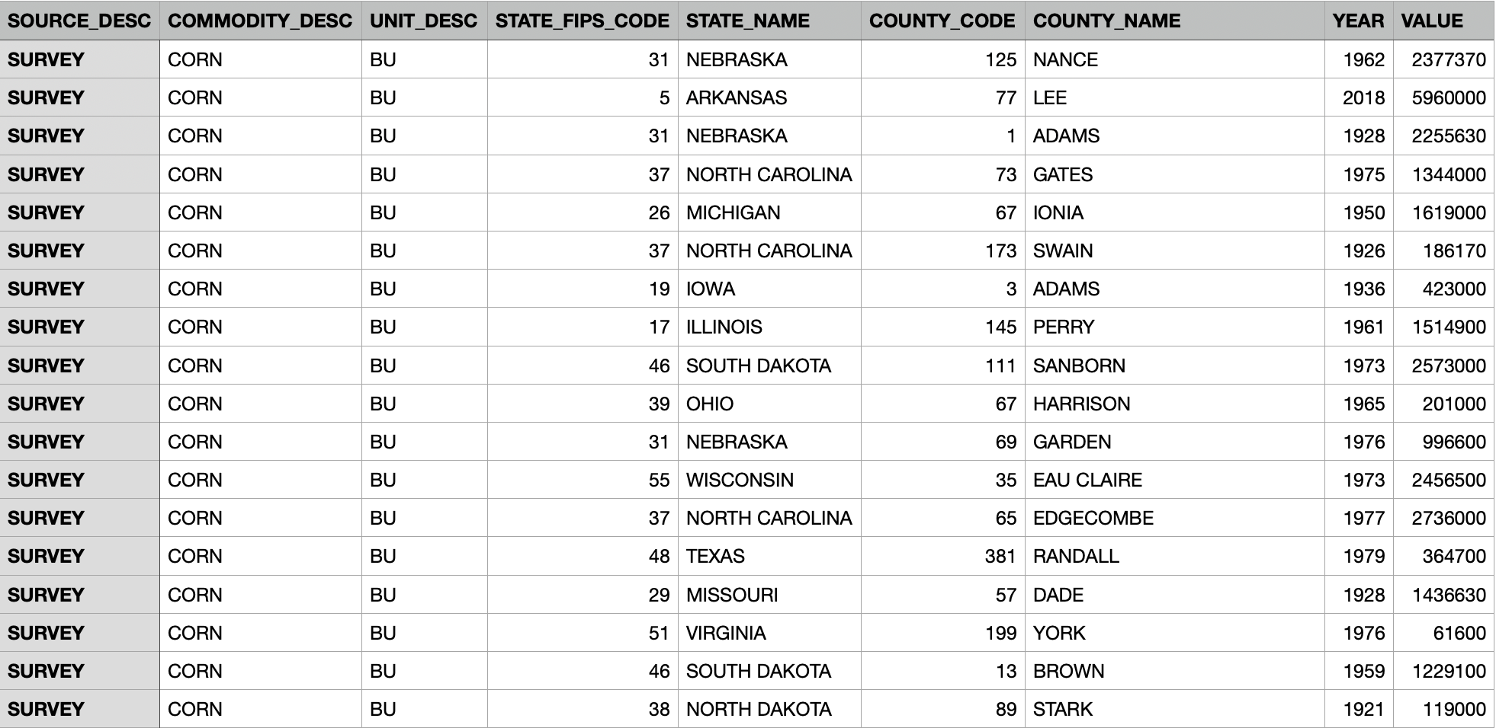
Data Table Snapshot

Slide 7
Application Architecture Overview
The backend of the application is programmed in Python. It utilizes the libraries: sklearn, pandas, and flask. It also involves a data filtering python file that helps slim down the data to only the specific state and county selected.
The front end of the application is programmed in Javascript, CSS, and React. It is a static web page that takes in input from the user on a state and county code. The data is sent to the back end to run a machine learning linear regression algorithm and

Slide 8
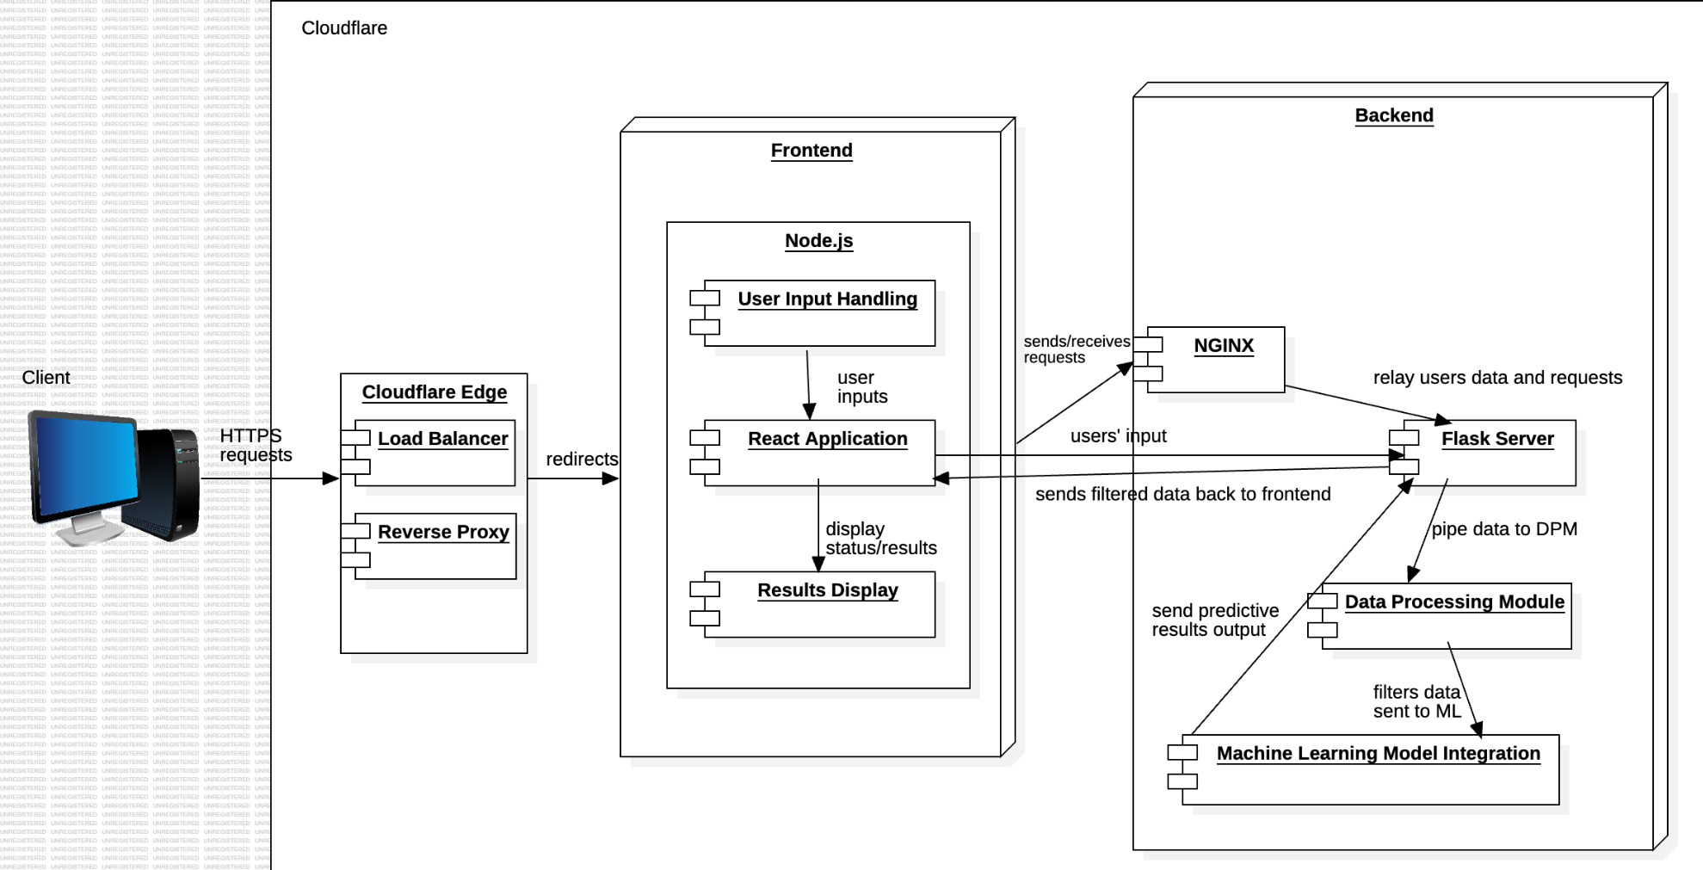
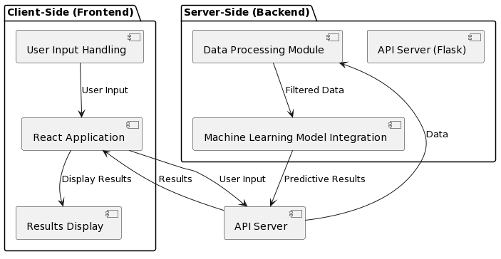
Architecture Diagram

Slide 9


Deployment Overview
Deployed on home servers
Lenovo Thinkstation P500 (host server)
Virtual Machine (1 CPU, 2 Threads, 8GB RAM, 64GB NVMe SSD)
Ubuntu Server 22.04 LTS
nginx-mainline + Cloudflared (proxying Cloudflare’s infrastructure and origin server)
Cloudflare Zero Trust
Reverse Proxy
Hides origin server’s IP for security
Load Balancing
Balance traffic across multiple origin servers in the backend (if needed)
Caching mechanisms on their edge servers to reduce load times for clients/users
Secure Tunneling
Unique IDs generated in association with origin servers on DNS list

Slide 10
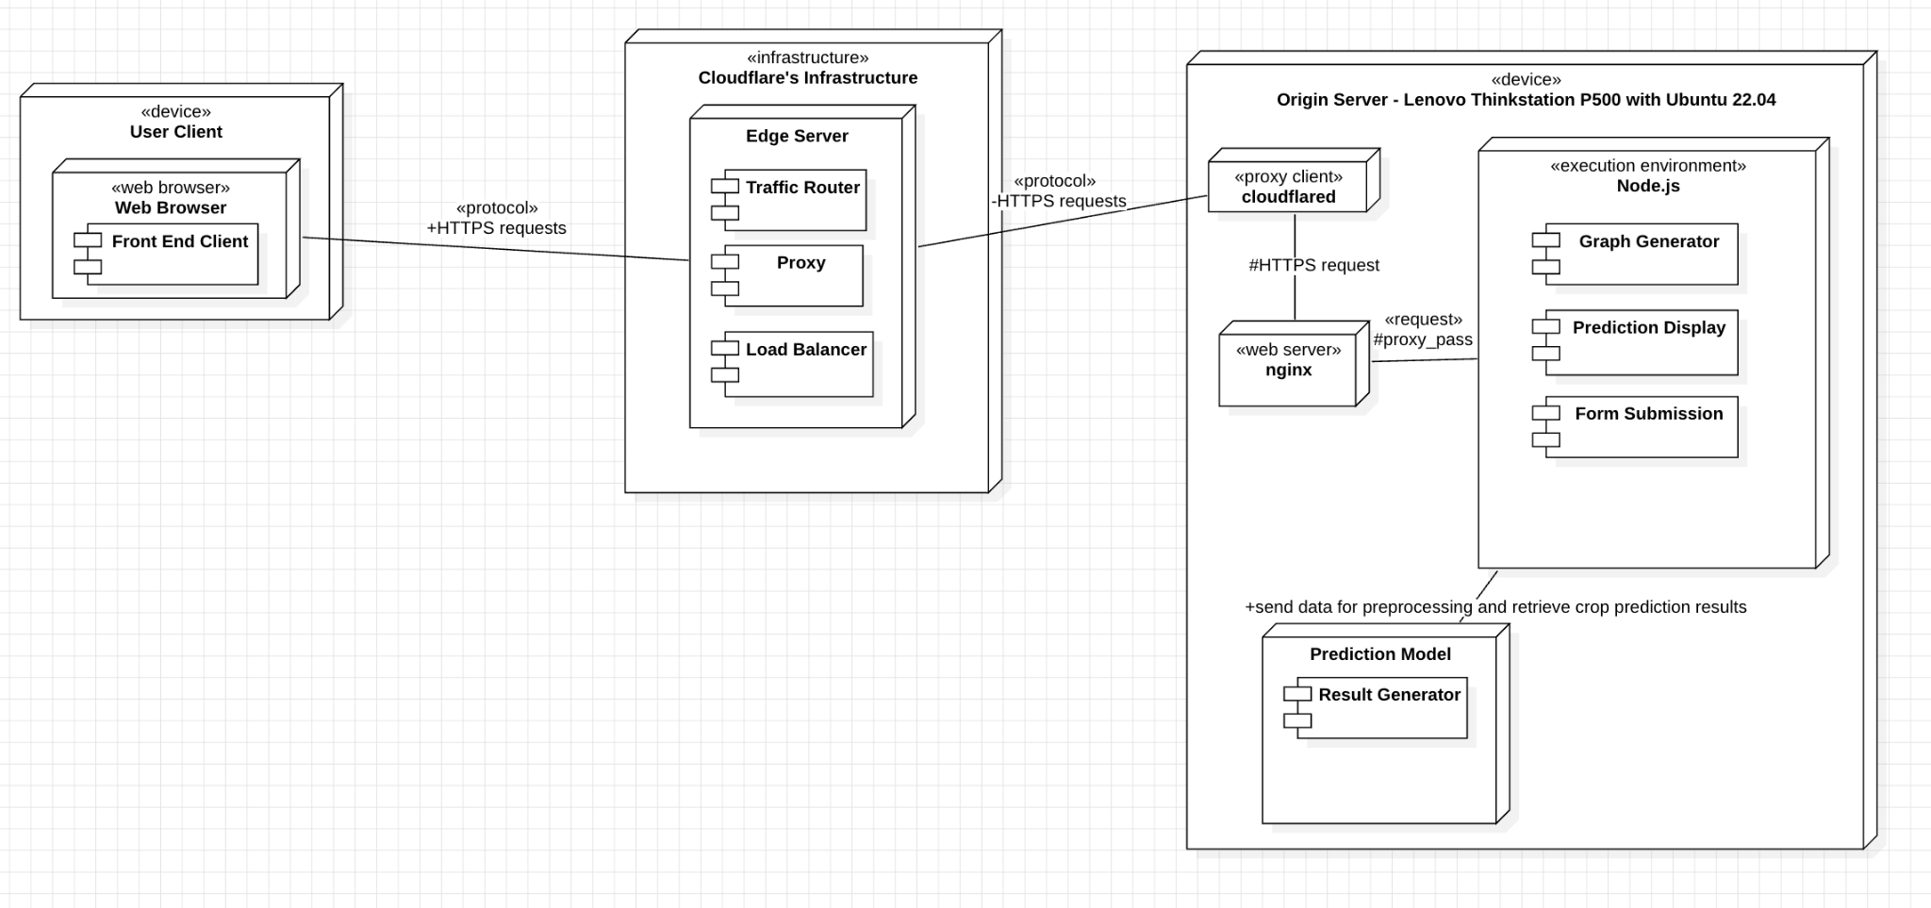
Deployment Diagram

Slide 11
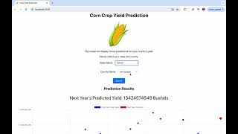
Presentation

Slide 12
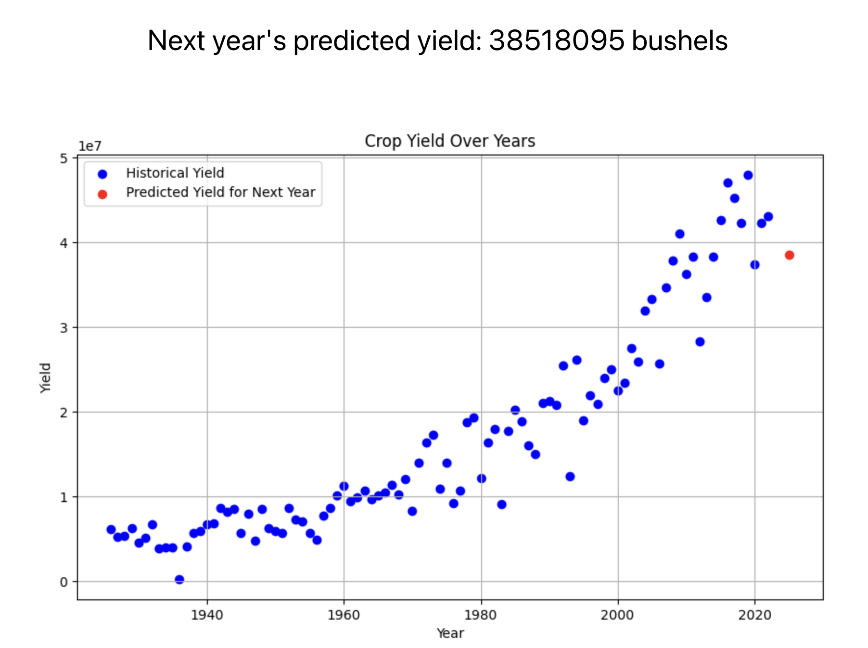
Results
Comprehensive overview/visualization of past crop yield data for a specific state / county
Predictive result for the coming year on what the expected crop yield will be
Aggregation of all counties per state yield and United States yield in total per year

Slide 13



Future Additions
Weather incorporation
Pesticide use
Expanding available crops
Expansion to global predictions outside of US
Specifics based upon farming equipment used

Slide 14
Questions?

